Slide 1
POSTMORTEM FINDINGS IN POISONING CASES
BY MS. MABEL CHANDRA
ASSISTANT PROFESSOR
SRINIVASAN COLLEGE OF ARTS & SCIENCE- TAMILNADU

Slide 2
INTRODUCTION
POISON- Substance, natural or synthetic, that causes damage to living tissues and has an injurious or fatal effect on the body, whether it is ingested, inhaled, or absorbed or injected through the skin.
POSTMORTEM- An autopsy, or an examination of a human body after death. Also called a necropsy. An autopsy can include a physical examination, examination of internal organs, and specialized laboratory studies. Autopsies may be used to help determine the cause and manner of death.
POSTMORTEM FINDINGS- Changes observed in stomach, liver, urine, blood, spleen etc.

Slide 3
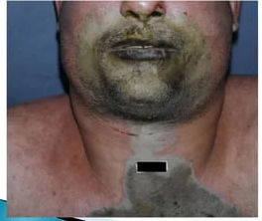
SULPHURIC ACID
AUTOPSY FINDINGS:
The cloths may show burns and stains.
Corrosion of mucuos membranes of lips, mouth, throat and of the skin over the chin, angles of the mouth and hands is seen.
The necrotic are at first grayish white but soon become brown or black and leathery.
Internal changes are limited to the upper digestive tract and respiratory.

Slide 4
Cont.
Upper Digestive Tract is inflamed and swollen by oedema and severe interstitial hamorhhage.
The greater part of stomach may be converted into a soft boggy, black mass which readily disintegrates when touch.
The small intestine may show signs of irritation.
Corrosion or severe inflammation of the larynx and the trachea may be present.
ML ASPECTS- (1) Most cases are suicidal. (2) Not used for homicide. (3) Accidental cases are rare.

Slide 5
CASE STUDY
Who - (a) Victim- 18 year old goldsmith
What- An 18-year-old unmarried male goldsmith was brought by his relatives to the psychiatric outpatient service of a general hospital. The patient had strong ideas of suicide and had made plans for hanging, drowning, and consumption of a large number of sedative tablets. On enquiry, he was found to have symptoms of sadness, easy fatigability, lack of concentration, sleeplessness, lack of appetite, and loss of interest in work and daily activities with a duration of 3 weeks. Result of his physical examination was unremarkable. Thus, on clinical evaluation, the diagnosis of a severe major depressive disorder was arrived at.

Slide 6
CASE STUDY
The patient became increasingly restless and was clutching his upper abdomen. On enquiry, he complained of burning pain in his chest and upper abdomen. His blood pressure was 130/70 mm Hg, his pulse was 120 beats per minute, and his pupils were of midsize and nonreactive to light. At this stage, a tentative diagnosis of acid poisoning was made and he died after 2 hours. An autopsy was performed 6 hours after death.
When and Where- Karnataka

Slide 7
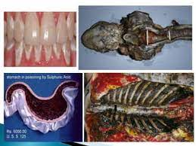
CASE STUDY
Evidence- The gross findings revealed extensive demarcated cutaneous burns on the inner aspect of the lips. The stomach was perforated, discolored, and disfigured. The liver and spleen were fixed to the thoracic cage. They were hardened on their outer surface and were covered with approximately 2 cm of the firm gray tissue on the surface.

Slide 8
NITRIC ACID
AUTOPSY FINDINGS:
Findings are similar to those of Sulphuric acid but the tissues are stained yellow.
Perforation of the stomach is not common. In death from inhalation of fumes, the larynx, trachea and bronchi are congested and lungs are oedematus.

Slide 9
CASE STUDY
Who: 60- year-old -man, a farmer.
What- On September 2015, a 60- year-old -man, a farmer , was found dead in the middle of rice fields belonging to Public Works Department (a land on the river banks of irrigation that has long been cultivated by the victim). He was one of the working farmer protesting the illegal dredging project). Beside the deceased, a hoe and a bottle made of “plastic” (used fertilizer container classified as moderate acid) lying beside the deceased, giving an impression that the victim commited suicide by consuming the liquid.

Slide 10
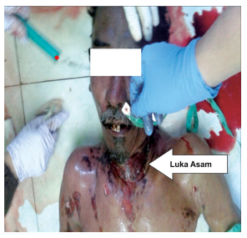
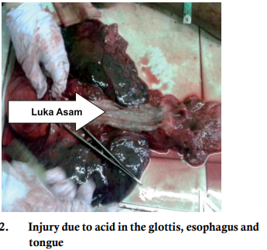
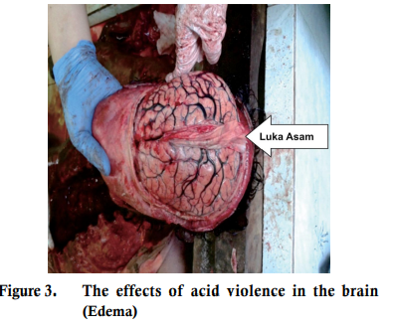
CASE STUDY
The external examination showed: Reddish brown or black burn marks, dry and hard on the eyelids, nostrils, lips, tongue, neck and chest (Figure 1).
Signs of irritation of the tongue, larynx, edema of the glottis and esophagus. (Fig 2)
Brain edema. (Fig 3)

Slide 11
HYDROCHLORIC ACID
AUTOPSY FINDINGS
Findings are similar to Sulphuric acid, but corrosion is less severe.
Perforation of stomach is rare.
Acute inflammation and oedema of respiration tract and lungs are common.

Slide 12
CASE STUDY
Who -(a) Victim- 61 year old woman
What- 61-year-old woman who orally ingested 200 ml of concentrated hydrochloric acid (30–33%) from a storage container in a suicide attempt. She complained about intensive pain in her mouth and throat, hoarseness and difficult swallowing. On examination she did not show any abnormalities except for significant signs of chemical burn in her mouth and a slightly swollen tongue.

Slide 13
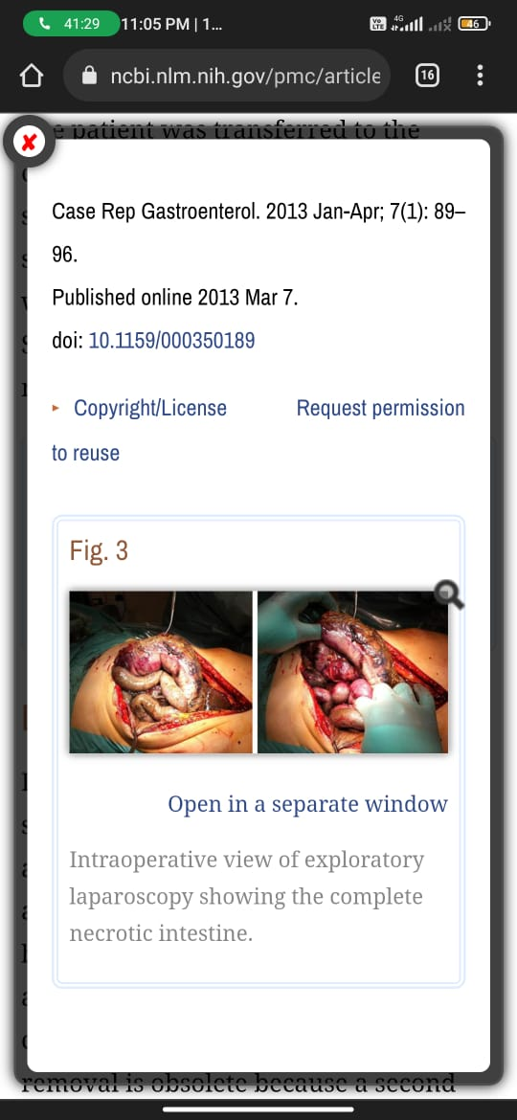
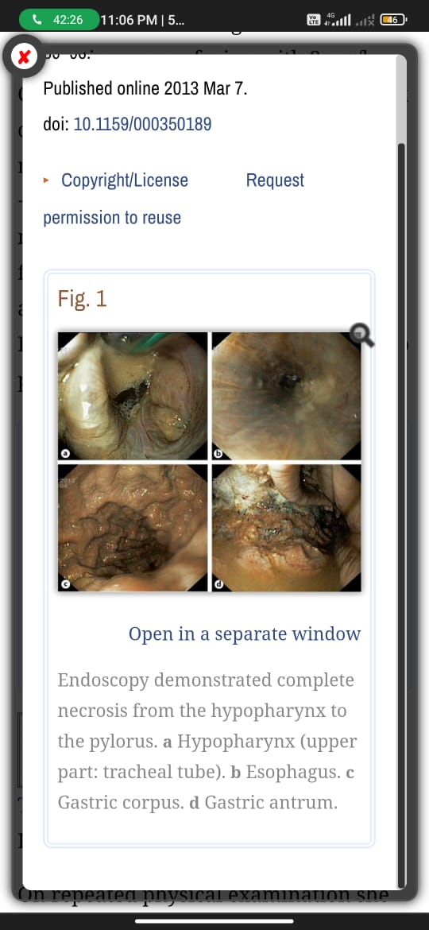
CASE STUDY
Evidence- she showed a completely necrotic stomach, small and large intestine without any therapeutic options. She died 10 h after admission from multiorgan failure.
Necrotic Intestine Necrotic Trachea, Esophagus, Gastric Cotpus, Gastric antrum

Slide 14
CARBOLIC ACID
AUTOPSY FINDINGS
Corrosion of the skin has a grayish or brown colour.
Tongue is white and swollen, and there is smell of about the mouth.
The mucous membrane of the lips, mouth and throat is corrugated and arranged in longitudinal folds.
The stomach is hardened and has a leathery feel.
The upper part of small intestine may show similar but mild changes.

Slide 15
Cont.
The liver and spleen usually show a whitish hardened patch where the stomach has been in contact with them.
The brain is congested and may be oedematous.
ML ASPECTS- (1) It is used for suicide. (2) Homicide and accident are rare.

Slide 16
CASE STUDY
Who -(a) Victim- 28-year-old male
What- A 28-year-old male patient was admitted to hospital. He had consumed phenyle (household toilet cleaner). On further examination, the patient was found to be hypotensive and tachypneic with bilateral constricted pupils. He was immediately admitted in the ICU, but after 4-5 hours he succumbed. The dead body was sent for autopsy.

Slide 17
CASE STUDY
Evidence- On external examination
Corrosion and greyish discoloration present at the angle of mouth and inner aspect of lips.
On internal examination
The tongue was white and swollen.
Mucous membrane of oral cavity was also sodden with ash gray discoloration.
The mucosa of the oesophagus was tough and grayish-white.

Slide 18
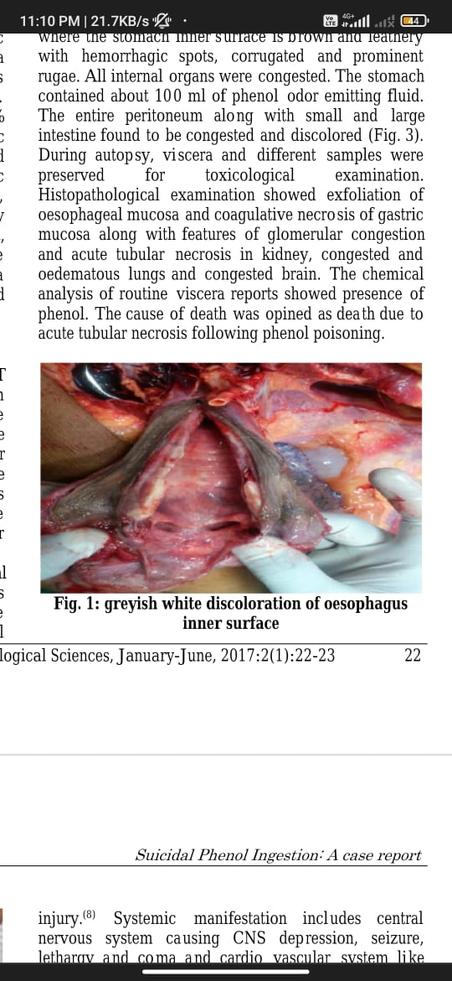

Slide 19
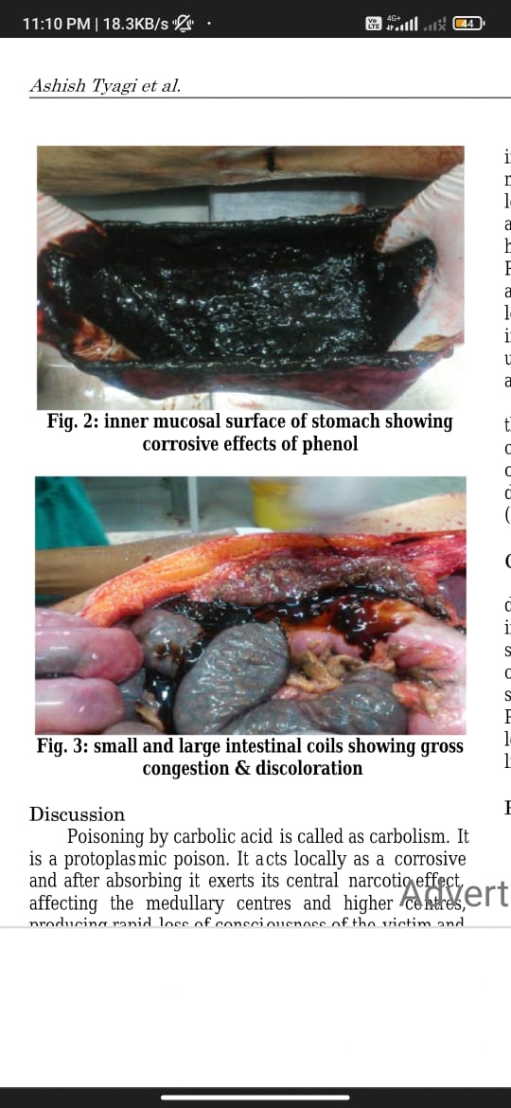
CASE STUDY
Mucosa of the stomach was softened, blackened, tarry, corroded, grossly hemorrhagic, ulcerated and congested.
The stomach contained about 100 ml of phenol odor emitting fluid.
Small and large intestine found to be congested and discolored

Slide 20
OPIUM
AUTOPSY FINDINGS
Signs of asphyxia are prominent.
Froth is seen at the mouth and nose.
Smell of opium is noted on opening the chest.
Stomach may contain small lumps of opium.
Lungs are congested and oedematous.
Internal organs are congested.
ML ASPECTS- It is an ideal suicidal poison. Homicide is rare.

Slide 21
CASE STUDY
Who -(a) Victim- 21-year-old man
What- A 21-year-old man (62.3 Kg) was found dead in a hotel room. External examination showed foamy whitish material partially solidified in the mouth and nostrils. Apart from multiple punctate and patchy abrasions, mainly on the chest and extremities, there were no other significant findings.

Slide 22
CASE STUDY
EVIDENCE- Internal examination revealed an oval package wrapped by the light yellow-white rubber strips (dimension: 30 × 12 mm; measured 3 cm) in the lower part of the esophagus.
At the dissection of the gastro-intestinal tract similarly shaped packages were attached from the stomach to the transverse colon, some of which ruptured and leaked out the dark brown content.
After clear the block mixed with the numbers of packages and dark brown pastes, there were found 13 oval packages including several broken ones and two incomplete wraps

Slide 23
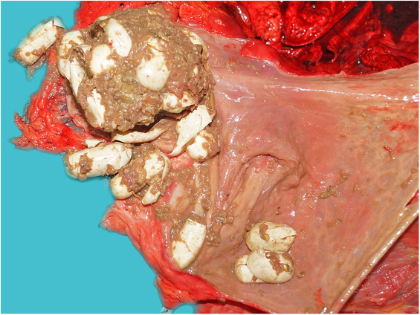
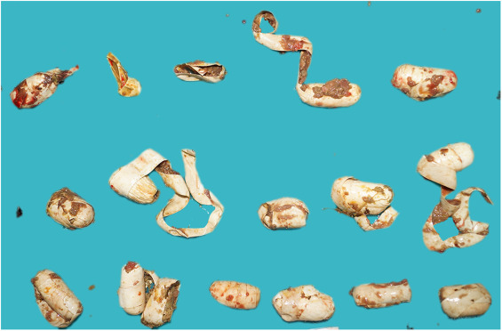
Block mixed by numbers of oval packages and dark brown pastes in the stomach.
Thirteen oval packages included several ones with external casing partially ruptured and no drug leakage
By instrumental analysis the death was confirmed by consumption of morphine.

Slide 24
CYANIDES
AUTOPSY FINDINGS
The eyes may be bright, glistening and prominent with dilated pupils.
The jaws are firmly closed and there is froth at the mouth.
The colour of the post-mortem staining is bright red.
Blood stained froth may be found in the trachea and bronchi.
There is congestion of viscera and oedema of the lungs.
All the vessels of the body including the veins contain arterial blood.

Slide 25
Cont.
The mucosa of the stomach and intestines is often red and congested.
Cyanide salts produce slight corrosion of mouth.
ML ASPECTS- (1) Used for suicide.
(2) Homicide is rare.

Slide 26
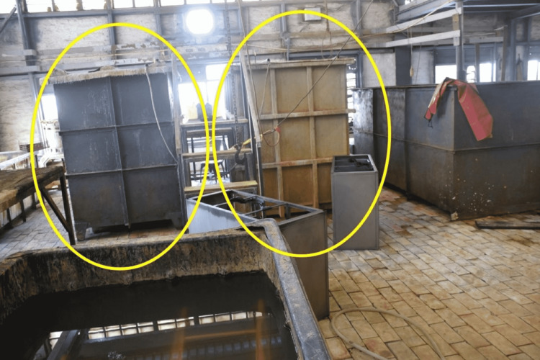
CASE STUDY
Accidental case in Industry
What- The incident occurred in a handicraft industry in Jodhpur city, Rajasthan, India, where metallic furniture like office tables, chairs, racks, etc., are manufactured. As per the police information, four workers suddenly fell unconscious while working in the electroplating chamber. Three workers were declared dead on reaching the hospital, while one could be saved. Death scene investigation revealed that the industry had big electroplating tanks.

Slide 27
CASE STUDY
On the fateful day, two workers were cleaning the electroplating tank. One of them got into the tank, and another person helped him by giving him the cleaning material. Upon entering the tank, the first worker suddenly fell unconscious and did not reply to the second worker's call. The second worker entered the tank and fell unconscious too. The other two co-workers working nearby came to the rescue, and they also fell unconscious in the tank. All four were immediately transferred to a nearby hospital. Out of the four, three were declared dead when they were brought to the hospital, while one was admitted and later discharged healthy after two days.

Slide 28
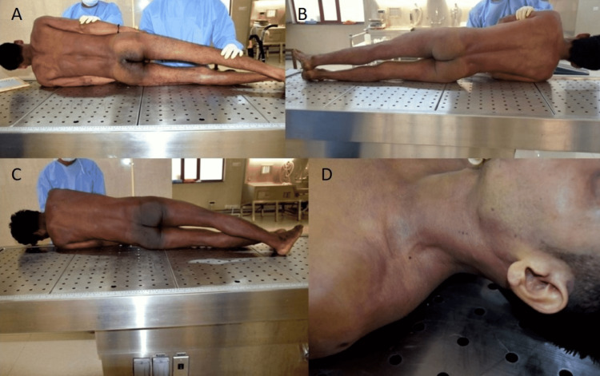
CASE STUDY
Evidence- At autopsy, all three deceased had similar findings.
The bodies of all three deceased showed pinkish post-mortem staining over the back and dependent regions.

Slide 29
CASE STUDY
Mucosal wall of the respiratory tract was congested
Lungs were congested and oedematous.
Both the lungs of all three deceased had multiple subpleural petechial hemorrhages.
Petechial hemorrhages were also seen on the epicardium.
The brain was congested and oedematous.
The stomach mucosa was congested.
The rest of the visceral organs were congested.
In the reported cases, the possible cause for the formation of toxic cyanide gas is the contact of electrolyte solutions containing cyanide ions with the acid while cleaning the electroplating tank, and the possible cause for exposure to such toxic gas is the unavailability of PPE.

Slide 30
DHATURA
AUTOPSY FINDINGS:
a) Fragments of seeds may be find in the stomach wash and intestine:
Vomit matter
Stomach Content
Faecal matter
b) Congestion appears in:
Oesophagus
Stomach
Deudonum
c) Inflammation occurs in rare cases in mucous membrane of the stomach.
d) Dilated pupils
e) Cyanosis
f) Seeds resists putrefaction hence can be recovered from decomposed body

Slide 31
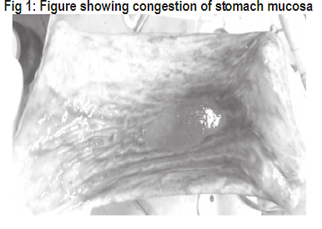
CASE STUDY
Who- 38 year old lady
What- A 38 year old lady was brought for autopsy with the history of taking some seeds. She was admitted to the hospital where she succumbed after 4 hours of admission. During hospital stay, she had fever, dilated pupils, difficulty in eating and breathing and convulsions.

Slide 32
CASE STUDY
Evidence-
Lungs were edematous and congestion of gastric mucosa was seen.(Figure 1)
Heart dissection did not reveal anything significant on gross examination.
Histopathology did not show any features of heart disease.
Chemical analysis showed presence of atropine in stomach contents, liver, kidney and blood.
It was concluded that death was due to respiratory paralysis as a result of consumption of datura seeds after ruling out all the other causes of death.

Slide 33
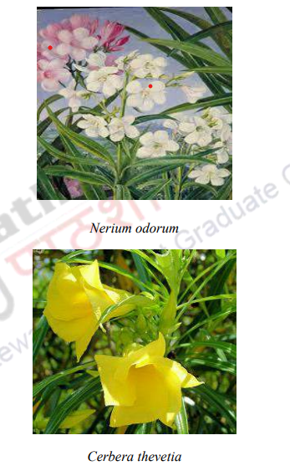
OLEANDER
AUTOPSY FINDINGS:
Signs of gastrointestinal irritation, congestion of various organs, and endocardinal ecchymoses caused by bruising.
It resists putrefaction and can be detected even years after death in exhumed putrefied bodies.
Petechial hemorrhages on heart are a characteristic feature.
Nerium odorum resists heat and can therefore be detected even from the burnt remains of the dead body.

Slide 34
CASE STUDY
Who- 18 year old female
Where- Autopsy conducted at Kolkata Police Morgue.
What- An 18 year old female, was allegedly being physically and mentally tortured for dowry by her husband and family. Ultimately, she took oleander nuts to commit suicide. She was taken to a nursing home in an unconscious state and expired 8 hours later.
EVIDENCE- conjunctiva was congested
brain was congested

Slide 35
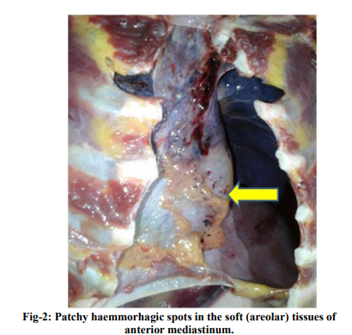
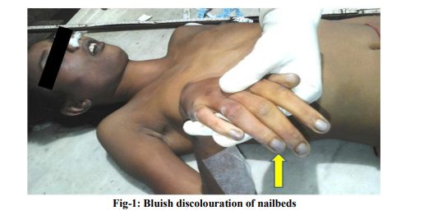
CASE STUDY
Evidence of bluish discoloration on the nail bed on both sides.(Fig 1)
On dissection, patchy haemmorhagic spots in the soft (areolar) tissues of anterior mediastinum was noted. (Fig 2)

Slide 36
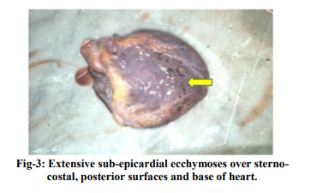
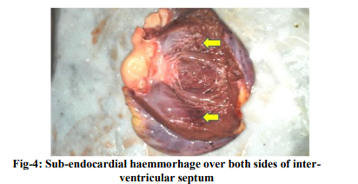
CASE STUDY
The heart had extensive sub-epicardial ecchymoses over sterno-costal, posterior surfaces and base. (Fig 3)
Sub-endocardial haemmorhage was present over both sides of the inter-ventricular septum. (Fig 4)

Slide 37
SNAKE BITE
AUTOPSY FINDINGS:
There will be the presence of fang marks which are about 1 cm to 2.5 cm deep depending upon the type of snake bitten with some swelling around the bitten part.
There are no characteristics findings indicating the cause of death except the signs of asphyxia.
There will be severe oozing of blood from puncture site.
There are hemorrhages in lungs membranes.
Endocardial hemorrhages are seen especially in left ventricle.
Petechiae are also found within kidney and mucousa of urinary bladder, stomach and intestines.

Slide 38
CASE STUDY
Who- Woman aged 78 years
What- The bodies of an elderly couple, the man aged 84 years and the woman aged 78 years, were brought to the mortuary for medico-legal autopsy with history of snake bite. As per the investigation officer, the woman was the second wife of the man deceased, and they were living separately from their children.On the fateful day, both the victims were kidnapped along with their driver. The couple was forcefully asked to sit in the car and their driver was told to sit in another four-wheeler. The kidnapper took them to a distant confined area. On the way, the snake charmer, who was sitting by the side of the kidnapper in the front seat of the car, took out a poisonous snake from a box and made it bite the couple. The couple collapsed immediately. After that, the kidnapper threatened the couple’s driver and told him to take the couple to the hospital saying that a snake had bitten them. The driver took the couple to the private hospital where they were declared dead. The couple died within one hour of the snake bite. An in-depth probe revealed that the eldest son of the elderly couple had plotted their murder over a property dispute, had hired the contract killer and had also arranged the snake charmer to have his parents killed.

Slide 39
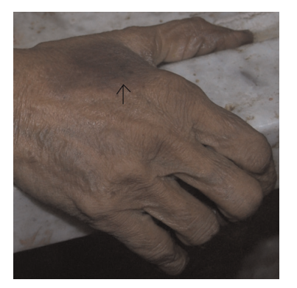
CASE STUDY
Evidence-
The deceased woman was of average build with the tongue tip clenched between the teeth.
Signs of cyanosis were present in the fingertips.
Signs of rigor mortis were present in the whole body and postmortem lividity was present on the back of the body.
Small reddish abrasions were present over the left eyebrow and the left lateral malleolus.
Two fang marks of snake bite were present on the dorsal aspect of the right hand between the thumb and the index finger, 3 mm apart with bluish-reddish discolouration and swelling present in the surrounding area over the entire hand (Figure).

Slide 40
CASE STUDY
The cut section showed a reddish fluid oozing out with oedema and haemorrhage present in the soft tissue underneath.
On internal examination, visceral organs were congested.
The lungs and the brain were congested and oedematous.
The kidneys were congested with corticomedullary haemorrhages present.
Dark-red fluid blood was present in heart.

Slide 41
MERCURY
AUTOPSY FINDINGS:
Pupils dilated

Slide 42
CASE STUDY
Who- 19-year-old Male
What- A 19-year-old Male was brought dead to the casualty after being treated in a private hospital for ingestion of unknown quantity of a powdered unknown poisonous substance. According to the police inquest, the boy was doing his second year graduation in leather engineering in a reputed college in Chennai. The boy has allegedly consumed unknown quantity of a powdered unknown poisonous substance which he has taken it from his college lab. He has consumed poison to commit suicide due to the reason mentioned in the suicide note he left at home). After 7 hours of consumption, he developed shortness of breath, burning sensation of mouth and stomach.The deceased survived for 21 hours after poison consumption.

Slide 43
CASE STUDY
Blood oozed out from both the nostrils and oral cavity. Cornea hazy, pupils dilated and fixed. Diffuse erosion of the tongue, lips and oral mucosa. Lower lip was oedematous.
Post mortem hypostasis fixed on the back with areas of contact pallor.
EVIDENCES

Slide 44
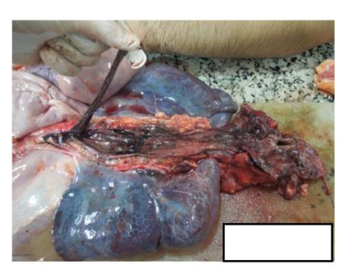
CASE STUDY
Oesophageal mucosa was friable, oedematous, blackened with diffuse erosions.

Slide 45
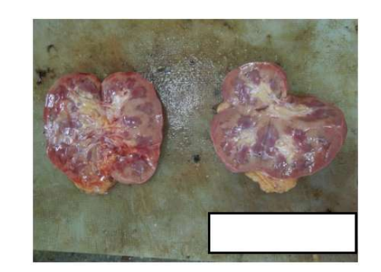
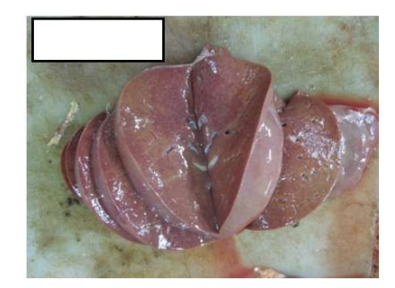
CASE STUDY
The Liver, Spleen and Kidneys were normal in size and appeared pale on cut section.

Slide 46
CASE STUDY
Chemical analysis report of viscera- Stomach and its contents, intestine and its contents, liver and kidney, brain and blood all detected a heavy metal salt Mercuric Acetate.

Slide 47
THANK YOU

